Slide 1

Machine Vision CHC6781
Lecture 6:
Artificial Neural Networks (ANN)
Module Leader: Dr Happy N. Monday
Contact via:
Email: happy.monday@zy.cdut.edu.cn
Office: Room 8102

Slide 2

Class Rules
Be on time
Bring your stuff (Pen, papers, folder, brain)
No pressing of phone, or gaming in the class.
Habit of Effective learners.
Prepare for your coursework and exam on time.
Always revise your PPTs before and after class.
Have Fun

Slide 3
Learning Outcomes
Understand the essential of activation functions for creating expressive neural networks that can model complex relationships
Understand the concept of layers to design and customize neural network architectures for various tasks.
Understand the neural network formula for comprehending how information flows through
Understand the concept of neural network architecture and its application in various domains.

Slide 4
References
1. Richard Szeliski. (2017). Computer Vision: Algorithms and Applications. Springer
2. Géron, A. (2019). Hands-On Machine Learning with Scikit-Learn, Keras, and TensorFlow. O'Reilly Media.
3. Aggarwal, C.C. (2018). Neural Networks and Deep Learning. Springer
4. Goodfellow, I., Bengio, Y., & Courville, A. (2016). Deep Learning. MIT Press.
5. Hastie, T., Tibshirani, R., & Friedman, J. (2009). The Elements of Statistical Learning: Data Mining, Inference, and Prediction. Springer.
Gulli, A, Pal, S. (2017). Deep Learning with Keras. Packt Publishing
Montavon, G. Orr, G. Muller, K.K. (2012). Neural Networks: Tricks of the Trade. Springer.

Slide 5
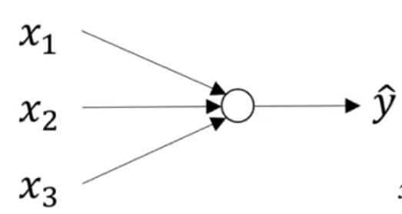
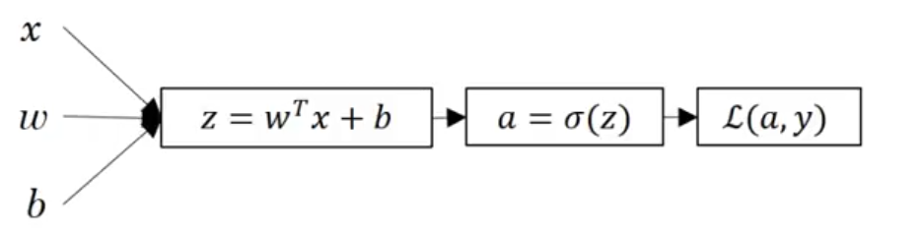
What is a Neural network?
Logistic Regression
= a

Slide 6
What is a Neural network?
Let’s look at Logistic Regression
Sigmoid Unit/Neuron
= a
z
Weighted input
Apply activation
Loss function

Slide 7
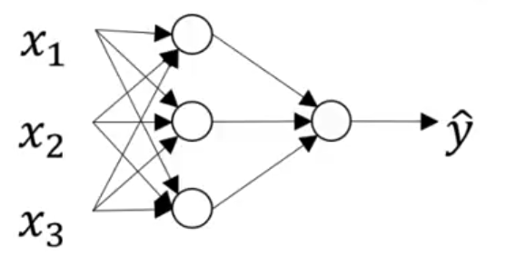
What is a Neural network?
Neural Network = two or more logistic regression stacked together.
z

Slide 8


What is a Neural network?
Neural Network = two or more logistic regression stacked together.
$$\left[1\right]$$
$$\left[2\right]$$

Slide 9





What is a Neural network?
Neural Network = two or more logistic regression stacked together.
$$\left[1\right]$$
$$\left[2\right]$$
$$x$$
$$W^{\left[1\right]}$$
$$b^{\left[1\right]}$$

Slide 10

What is a Neural network?
Neural Network = two or more logistic regression stacked together.
$$\left[1\right]$$
$$\left[2\right]$$
$$x$$
$$W^{\left[1\right]}$$
$$z^{\left[1\right]}=W^{\left[1\right]}x+b^{\left[1\right]}$$
$$b^{\left[1\right]}$$

Slide 11


What is a Neural network?
Neural Network = two or more logistic regression stacked together.
$$\left[1\right]$$
$$\left[2\right]$$
$$x$$
$$z^{\left[1\right]}$$
$$W^{\left[1\right]}$$
$$z^{\left[1\right]}=W^{\left[1\right]}x+b^{\left[1\right]}$$
$$a^{\left[1\right]}=σ{(z}^{\left[1\right]})$$
$$b^{\left[1\right]}$$

Slide 12





What is a Neural network?
Neural Network = two or more logistic regression stacked together.
$$\left[1\right]$$
$$\left[2\right]$$
$$z^{\left[2\right]}$$
$$x$$
$$z^{\left[1\right]}$$
$$W^{\left[1\right]}$$
$$z^{\left[1\right]}=W^{\left[1\right]}x+b^{\left[1\right]}$$
$$a^{\left[1\right]}=σ{(z}^{\left[1\right]})$$
$$z^{\left[2\right]}=W^{\left[2\right]}a^{\left[1\right]}+b^{\left[2\right]}$$
$$W^{\left[2\right]}$$
$$b^{\left[1\right]}$$
$$b^{\left[2\right]}$$

Slide 13

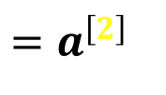




What is a Neural network?
Neural Network = two or more logistic regression stacked together.
$$\left[1\right]$$
$$\left[2\right]$$
$${=a}^{\left[2\right]}$$
$$z^{\left[2\right]}$$
$$z^{\left[1\right]}$$
$$x$$
$$W^{\left[1\right]}$$
$$z^{\left[1\right]}=W^{\left[1\right]}x+b^{\left[1\right]}$$
$$a^{\left[1\right]}=σ{(z}^{\left[1\right]})$$
$$z^{\left[2\right]}=W^{\left[2\right]}a^{\left[1\right]}+b^{\left[2\right]}$$
$$a^{\left[2\right]}=σ{(z}^{\left[2\right]})$$
$${𝓛(a}^{\left[2\right]},y)$$
$$W^{\left[2\right]}$$
$$b^{\left[1\right]}$$
$$b^{\left[2\right]}$$

Slide 14
Neural network Representation
Notation Convention

Slide 15
Neural network Representation
Notation Convention
Input
layer
Hidden
layer
Output
Layer

Slide 16
Neural network Representation
Notation Convention
Input Layer: this contains the input value ‘x’ to the neural network.
Hidden Layer: the true value of this node is not observable.
Output Layer: responsible for generating the predicted value ‘y’
Input
layer
Hidden
layer
Output
Layer:
2 layer Neural Network

Slide 17




Neural network Representation
Notation Convention
$$a^{\left[0\right]}=x$$
Input Layer: this contains the input value ‘x’ to the neural network.
$$a^{\left[1\right]}$$
$$a^{\left[2\right]}$$
Hidden Layer: the true value of this node is not observable.
$${=a}^{\left[2\right]}$$
Output Layer: responsible for generating the predicted value ‘y’
Input
layer
Hidden
layer
Output
Layer:
2 layer Neural Network

Slide 18
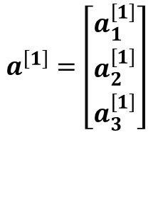
Neural network Representation
Notation Convention
$$a^{\left[0\right]}=x$$
Input Layer: this contains the input value ‘x’ to the neural network.
$$a^{\left[1\right]}$$
$$a^{\left[2\right]}$$
Hidden Layer: the true value of this node is not observable.
$${=a}^{\left[2\right]}$$
Output Layer: responsible for generating the predicted value ‘y’
$$a^{\left[1\right]}=\left[\begin{aligned}a_{1}^{\left[1\right]} \\ a_{2}^{\left[1\right]} \\ a_{3}^{\left[1\right]}\end{aligned}\right]$$
The hidden layer will generate an activation of 3-dimentional vector (4 by 1 matrix)
Input
layer
Hidden
layer
Output
Layer:
2 layer Neural Network

Slide 19

Neural network Representation
Notation Convention
$$a^{\left[0\right]}=x$$
$$W^{\left[1\right]},b^{\left[1\right]}$$
Input Layer: this contains the input value ‘x’ to the neural network.
$$a^{\left[1\right]}$$
$$a^{\left[2\right]}$$
Hidden Layer: the true value of this node is not observable.
$${=a}^{\left[2\right]}$$
Output Layer: responsible for generating the predicted value ‘Y’
$$a^{\left[1\right]}=\left[\begin{aligned}a_{1}^{\left[1\right]} \\ a_{2}^{\left[1\right]} \\ a_{3}^{\left[1\right]}\end{aligned}\right]$$
The hidden layer will generate an activation of 3-dimentional vector (4 by 1 matrix)
Input
layer
Hidden
layer
Output
Layer:
2 layer Neural Network

Slide 20


Neural network Representation
$$W^{\left[1\right]},b^{\left[1\right]}$$
$$\left(4,3\right),\left(4,1\right)$$
$$a^{\left[0\right]}=x$$
Input Layer: this contains the input value ‘x’ to the neural network.
$$a^{\left[1\right]}$$
$$a^{\left[2\right]}$$
Hidden Layer: the true value of this node is not observable.
$${=a}^{\left[2\right]}$$
Output Layer: responsible for generating the predicted value ‘Y’
$$a^{\left[1\right]}=\left[\begin{aligned}a_{1}^{\left[1\right]} \\ a_{2}^{\left[1\right]} \\ a_{3}^{\left[1\right]}\end{aligned}\right]$$
The hidden layer will generate an activation of 3-dimentional vector (4 by 1 matrix)
Input
layer
Hidden
layer
Output
Layer:
2 layer Neural Network

Slide 21



Neural network Representation
$$W^{\left[1\right]},b^{\left[1\right]}$$
$$\left(3,3\right),\left(3,1\right)$$
$$a^{\left[0\right]}=x$$
$$W^{\left[2\right]},b^{\left[2\right]}$$
Input Layer: this contains the input value ‘x’ to the neural network.
$$a^{\left[1\right]}$$
$$\left(1,3\right),\left(1,1\right)$$
$$a^{\left[2\right]}$$
Hidden Layer: the true value of this node is not observable.
$${=a}^{\left[2\right]}$$
Output Layer: responsible for generating the predicted value ‘Y’
$$a^{\left[1\right]}=\left[\begin{aligned}a_{1}^{\left[1\right]} \\ a_{2}^{\left[1\right]} \\ a_{3}^{\left[1\right]}\end{aligned}\right]$$
The hidden layer will generate an activation of 3-dimentional vector (3 by 1 matrix)
Input
layer
Hidden
layer
Output
Layer:
2 layer Neural Network

Slide 22
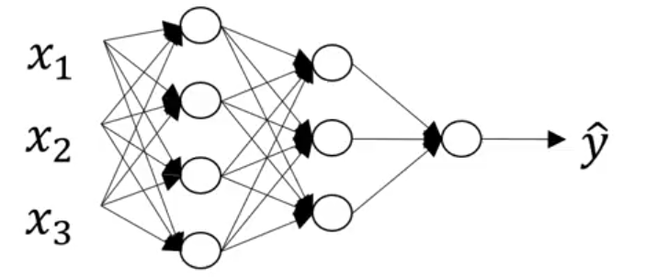


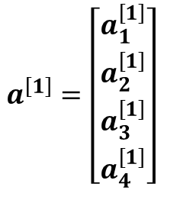
Neural network Representation
$$W^{\left[1\right]},b^{\left[1\right]}$$
$$\left(4,3\right),\left(4,1\right)$$
$$a^{\left[0\right]}=x$$
$$W^{\left[2\right]},b^{\left[2\right]}$$
Input Layer: this contains the input value ‘x’ to the neural network.
$$a^{\left[1\right]}$$
$$\left(1,4\right),\left(1,1\right)$$
$$a^{\left[2\right]}$$
Hidden Layer: the true value of this node is not observable.
$${=a}^{\left[2\right]}$$
Output Layer: responsible for generating the predicted value ‘Y’
$$a^{\left[1\right]}=\left[\begin{aligned}a_{1}^{\left[1\right]} \\ a_{2}^{\left[1\right]} \\ a_{3}^{\left[1\right]} \\ a_{4}^{\left[1\right]}\end{aligned}\right]$$
The hidden layer will generate an activation of 3-dimentional vector (4 by 1 matrix)
Input
layer
Hidden
layer
Output
Layer:
2 layer Neural Network

Slide 23
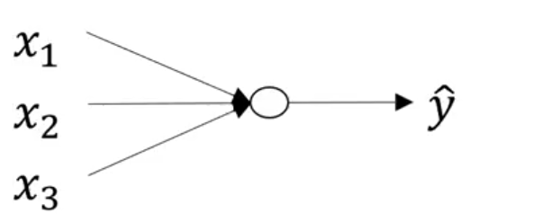
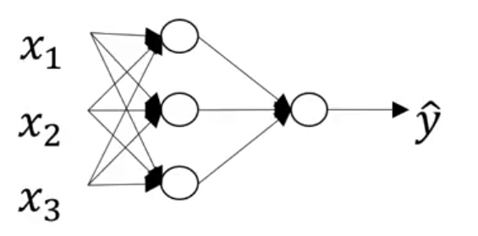
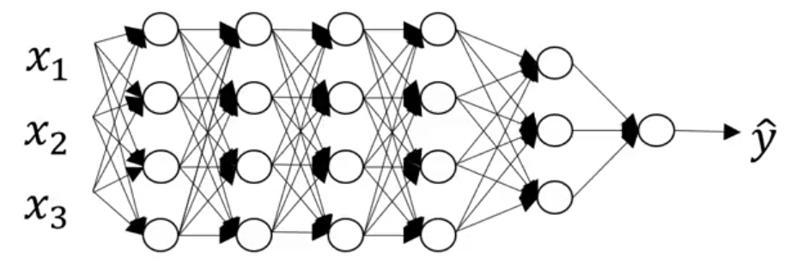
Deep Neural network
Logistic regression
1 hidden layer
2 hidden layers
5 hidden layers

Slide 24

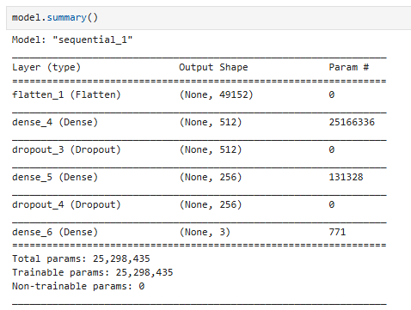
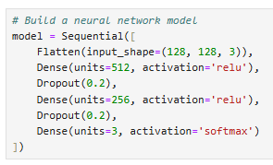
Neural Network Implementation
1
How many layers?

Slide 25
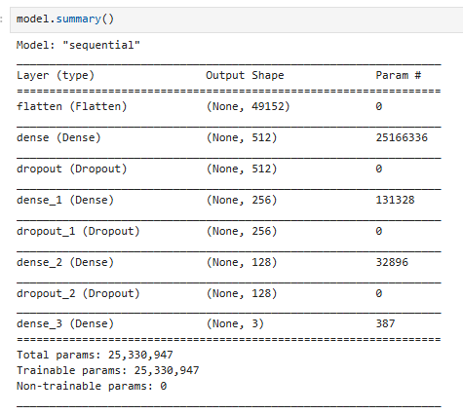
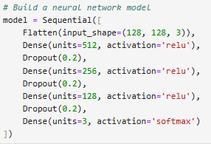
Neural Network Implementation
2
How many layers?

Slide 26
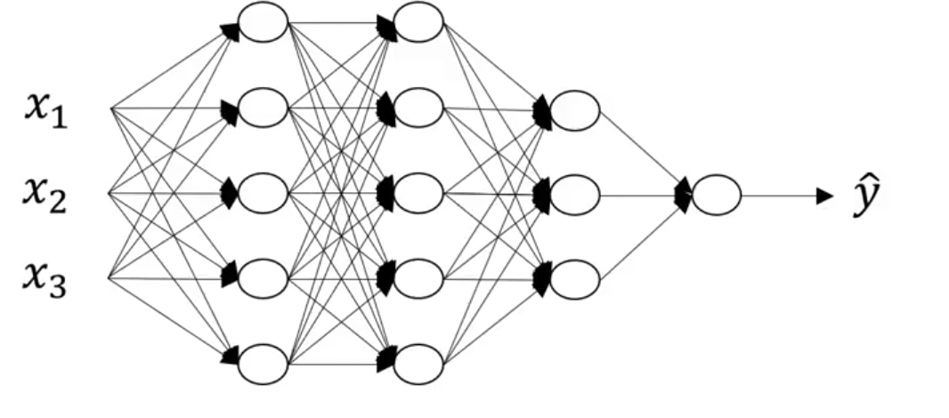
Deep Neural Network Notation
4 layer NN with 3 hidden layers

Slide 27
Deep Neural Network Notation
4 layer NN with 3 hidden layers
1
3
5
5
The number of units in each hidden layer

Slide 28



Deep Neural Network Notation
4 layer NN with 3 hidden layers
1
3
5
5
The number of units in each hidden layer
$l=4$ (number of layers)
$n^{\left[ℓ\right]}=$number of units/neurons in layer $ℓ$
$a^{\left[ℓ\right]}=$activations in layer $ℓ$

Slide 29
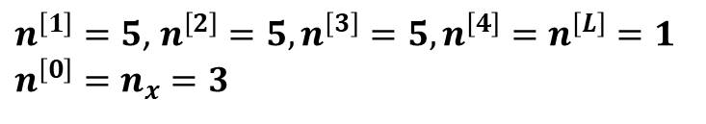




Deep Neural Network Notation
4 layer NN with 3 hidden layers
$${=a}^{\left[L\right]}$$
1
3
5
5
The number of units in each hidden layer
$n^{\left[1\right]}=5$, $n^{\left[2\right]}=5,n^{\left[3\right]}=5,n^{\left[4\right]}=n^{\left[L\right]}=1$
$$n^{\left[0\right]}=n_{x}=3$$
$l=4$ (number of layers)
$n^{\left[ℓ\right]}=$number of units/neurons in layer $ℓ$
$a^{\left[ℓ\right]}=σ^{\left[ℓ\right]}$($z^{\left[ℓ\right]}$)
$a^{\left[ℓ\right]}=$activations in layer $ℓ$
$W^{\left[ℓ\right]}=weights for$($z^{\left[ℓ\right]}$)
$$b^{\left[ℓ\right]}=bias$$

Slide 30
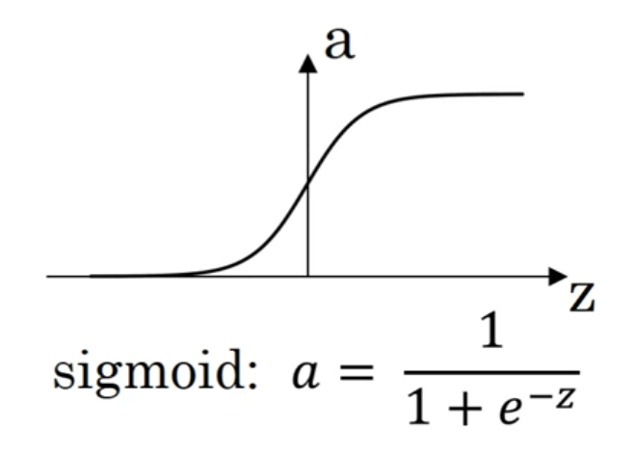
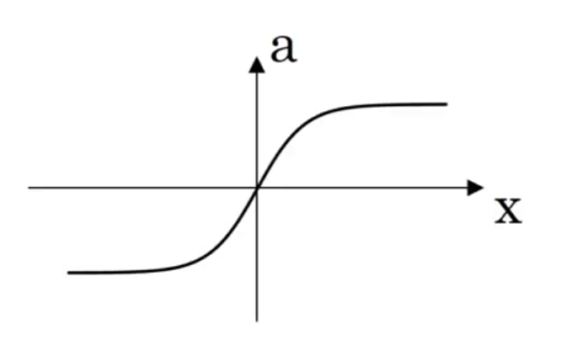
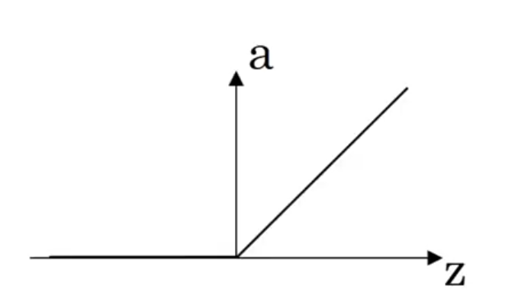
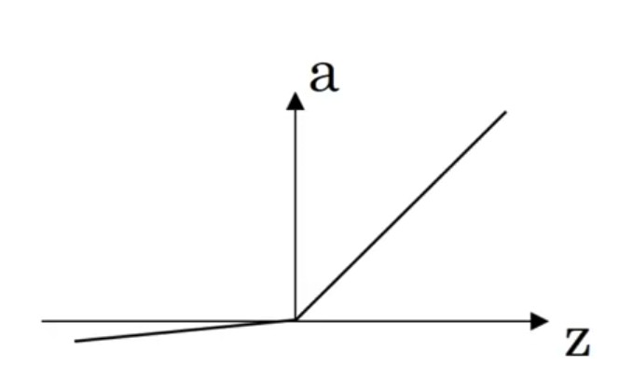



Activation Functions
$$a=\frac{e^{z}−e^{−z}}{e^{z}+e^{z}}$$
Tanh:
ReLU:
$$a=max\left(0,z\right)$$
Leaky ReLU:
$$a=max\left(0.01z,z\right)$$

Slide 31
The End!

